Slide 1
Operation Analytics and Investigating Metric Spike
BY-OM Ankesh

Slide 2
Job Data Analysis
Project Description
The primary objective of this project was to analyze job data to derive actionable insights and understand trends related to job reviews. The dataset includes information on job reviews performed by various actors, including details such as the event type, language of content, time spent reviewing, and more.
WE Have 3 tables to work on:
A) users: Contains one row per user, with descriptive information about that user’s account.
B) events: Contains one row per event, where an event is an action that a user has taken (e.g., login, messaging, search).
C) email_events: Contains events specific to the sending of emails.

Slide 3
Task -1 Jobs Reviewed Over Time
Objective: Calculate the number of jobs reviewed per hour for each day in November 2020.
Your Task: Write an SQL query to calculate the number of jobs reviewed per hour for each day in November 2020.
Query: SELECT ds as date, round((count(job_id)/sum(time_spent))*3600) as "jobs viewed per hour per day“ from job_data WHERE ds BETWEEN "2020-11-01" AND "2020-11-30" group by ds;
date, jobs viewed per
hour per day
2020-11-30 180
2020-11-29 180
2020-11-28 218
2020-11-27 35
2020-11-26 64
2020-11-25 80

Slide 4
Task 2:Throughput Analysis
Objective: Calculate the 7-day rolling average of throughput (number of events per second).
Your Task: Write an SQL query to calculate the 7-day rolling average of throughput. Additionally, explain whether you prefer using the daily metric or the 7-day rolling average for throughput, and why.
Query:
SELECT ds AS date, ROUND(COUNT(event) / SUM(time_spent), 2) AS daily_throughput, ROUND(AVG(COUNT(event) / SUM(time_spent)) over (ORDER BY ds ROWS BETWEEN 6 preceding AND current row), 2) AS rolling_7day_avg FROM job_dataGROUP BY dsORDER BY ds;
Date daily_throughput rolling_7day_avg
2020-11-25 | 0.02 | 0.02
2020-11-26 | 0.02 | 0.02
2020-11-27 | 0.01 | 0.02
2020-11-28 | 0.06 | 0.03
2020-11-29 | 0.05 | 0.03
2020-11-30 | 0.05 | 0.04

Slide 5
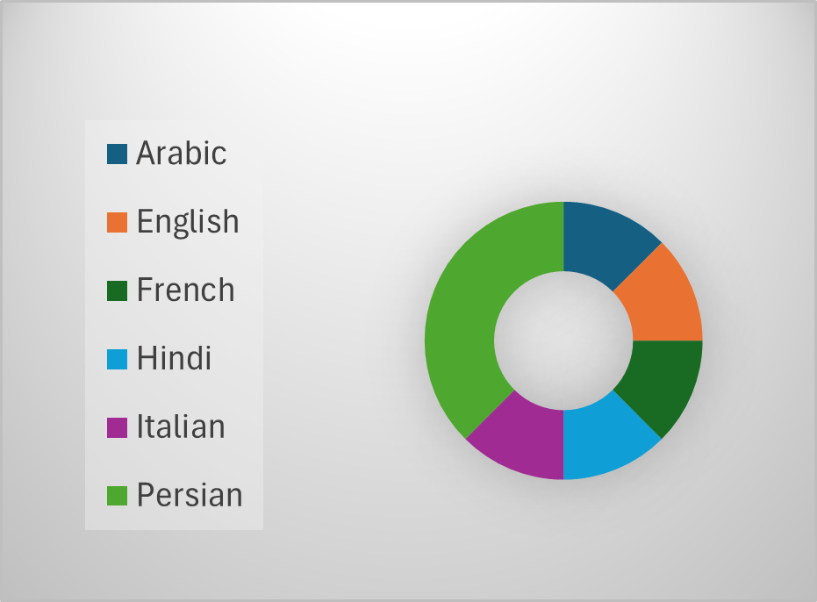
Task 3:Language Share Analysis:
Objective: Calculate the percentage share of each language in the last 30 days.
Your Task: Write an SQL query to calculate the percentage share of each language over the last 30 days.
Query:
SELECT language, round(((count(language)/8)*100),2) as lang_share FROM job_data group by language;
Language lang_share
English | 12.50
Arabic | 12.50
Persian | 37.50
Hindi | 12.50
French | 12.50
Italian | 12.50

Slide 6
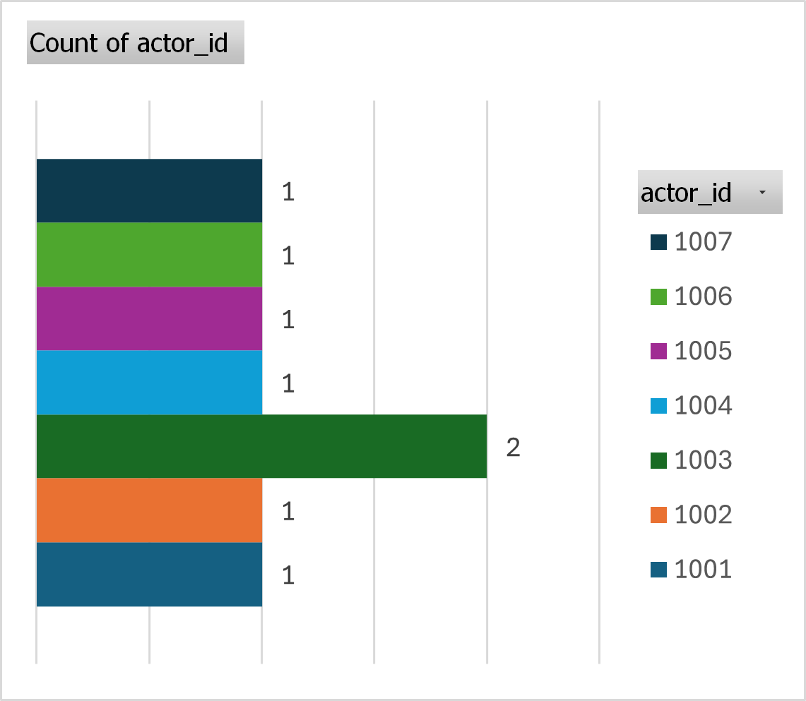
Task 4:Duplicate Rows Detection
Objective: Identify duplicate rows in the data.
Your Task: Write an SQL query to display duplicate rows from the job_data table.
Query:
SELECT actor_id, count(actor_id) as tot_count from job_dataGROUP BY actor_id HAVING tot_count>1;
actor_id tot_count
1003 | 2

Slide 7
Results
The analysis provided valuable insights into job review patterns, language distribution, and data quality. The key achievements include:
Understanding daily and rolling throughput trends, which aids in resource allocation and operational planning.
Identifying and addressing duplicate entries, improving data accuracy.
Gaining insights into language distribution, allowing for better focus on languages with higher representation.
These findings contribute to a better understanding of job review dynamics and support informed decision-making for improving processes and resource management.

Slide 8

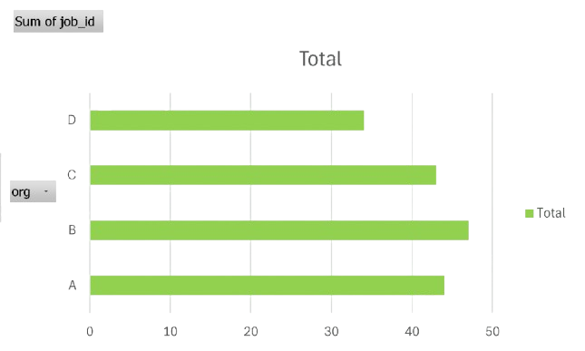
Investigating Metric Spike
Project Description
The objective of this project is to analyse email events data to evaluate the performance of email campaigns. The focus is on understanding the effectiveness of emails by calculating the open and click rates. This analysis helps in assessing how engaging and successful the email communications are.

Slide 9
Task -1 Weekly User Engagement
Objective: Measure the activeness of users on a weekly basis.
Your Task: Write an SQL query to calculate the weekly user engagement.
Query: select extract(week from occurred_at) as weeks,count(distinct user_id) as no_of_usersfrom eventswhere event_type ="engagement"group by weeksorder by weeks;
Weeks no_of_users
17 | 663
18 | 1068
19 | 1113
20 | 1154
21 | 1121
22 | 1186
We have many more rows we cant display here

Slide 10
Task -2 User Growth Analysis
Objective: Analyze the growth of users over time for a product.
Your Task: Write an SQL query to calculate the user growth for the product.
Query: SELECT week_num, year_num,sum(active_users) OVER (order by week_num, year_num rows between unbounded preceding AND current row) as cumulative_sumfrom (SELECT extract(week from activated_at) AS week_num,extract(year from activated_at) AS year_num,count(distinct user_id) AS active_users FROM userswhere state= "active"group by year_num, week_numorder by year_num, week_num) as alias;
week_num year_num cumulative_sum
0 | 2013 | 23
0 | 2014 | 106
1 | 2013 | 136
1 | 2014 | 262
2 | 2013 | 310
2 | 2014 | 419
We have many more rows we cant display here

Slide 11
Task -3 Weekly Retention Analysis
Objective: Analyze the retention of users on a weekly basis after signing up for a product.
Your Task: Write an SQL query to calculate the weekly retention of users based on their sign-up cohort.
Query: select extract(week from occurred_at) as weeks, count(distinct user_id) as no_of_users from eventswhere event_type="signup_flow" and event_name="complete_signup" group by weeks order by weeks;
Weeks no_of_users
17 | 72
18 | 163
19 | 185
20 | 176
21 | 183
22 | 196
We have many more rows we cant display here

Slide 12
Task -4 Weekly Engagement Per Device
Objective: Measure the activeness of users on a weekly basis per device.
Your Task: Write an SQL query to calculate the weekly engagement per device.
Query: select device, extract(week from occurred_at) as weeks, count(distinct user_id) as no_of_users from events where event_type="engagement"group by device, weeks order by weeks;
Device weeks no_of_users
acer aspire desktop | 17 | 9
acer aspire notebook | 17 | 20
amazon fire phone | 17 | 4
asus chromebook | 17 | 21
dell inspiron desktop | 17 | 18
dell inspiron notebook | 17 | 46
We have many more rows we cant display here

Slide 13
Task -5 Email Engagement Analysis
Objective: Analyze how users are engaging with the email service.
Your Task: Write an SQL query to calculate the email engagement metrics.
Query:
select (sum(case when email_category="email_opened" then 1 else 0 end)/sum(case when email_category="email_sent" then 1 else 0 end))*100 as open_rate,(sum(case when email_category="email_clickthrough" then 1 else 0 end)/sum(case when email_category="email_sent" then 1 else 0 end))*100 as click_ratefrom ( select *, case when action in ("sent_weekly_digest", "sent_reengagement_email") then ("email_sent") when action in ("email_open") then ("email_opened") when action in ("email_clickthrough") then ("email_clickthrough") end as email_category from email_events) as alias;
open_rate, click_rate
'33.5834’ '14.7899'

Slide 14
Results
The analysis provided valuable insights into the performance of email campaigns. The high open rate indicates good engagement, while the click rate suggests that while many recipients open the emails, fewer take further action. These insights can guide future improvements in email content and strategies to increase both open and click rates.

